Slide 1
Database Systems
Lecture #1 : Introduction
Section 5B: Mon, Sep 7, 2020 01:00 – 04:00
Section 5F: Wed, Sep 9, 2020 01:00 – 04:00
FAST – NU, Karachi
‹#›
Notes:
‹#›

Slide 2

Welcome to CL-203

Slide 3
Class Information
Email: farah.sadia@nu.edu.pk
Google Classroom 5F: mn6erxh
Google Classroom 5B: 236j72s
‹#›

Slide 4
Prerequisites
Data Structures
Strong Concept of Programming
‹#›

Slide 5
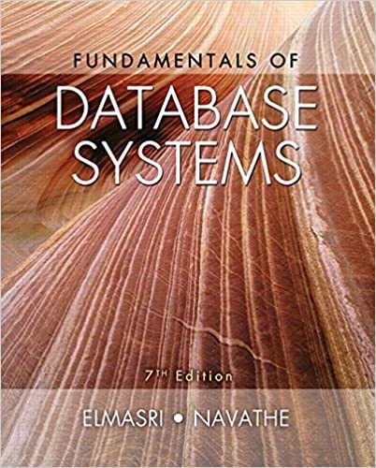
TextBook
Ramez Elmasri & Shamkant B. Navathe, Database Systems, Models, Languages, Design and Application Programming, 7th Edition, 2016.

Slide 6
Grading Scheme
All Labs – 20%
Project – 10%
Midterm – 15%
Final – 50%
Quiz -- 05%
‹#›

Slide 7
Grading Scheme
Late arrivals and Late submissions shall be penalized
Absolute grading will be used in this course
Students missing labs, can not pass lab course just by giving mid and final exams.
‹#›

Slide 8

Plagiarism Policy
When one student copies from another student, both students are responsible
The penalty for plagiarism in tasks and assignments, is a mark of 0 on the task/assignments in question and a further 5% is subtracted from your final grade

